Slide 1
Holdin' On: using music technology as a tool of cultural liberation with respect to performing masculinities at a young offenders' institution
Dr Ornette D Clennon
Visiting Enterprise Fellow
Manchester Metropolitan University

Slide 2
Background to the Project
HMPYOI Werrington for young men
2 year project: 2005 - 2007
Sonic [db] Music Technology in Prisons Project
Music and creative sessions to write songs about their experiences of crime and offending behaviour
Vocational training in music production

Slide 3
Project Aims
Music technology
Software used
Cubase SX
Fruity Loops Producer
Samples (CDs)
Hardware used
PC
Fantom XA (workstation)
Mics (Sennheiser)
Vocal Booth (‘home’ made microphone screen)

Slide 4
Project Aims
Music technology
Participatory focus – trainee led
Peer to peer mentoring
Modular training with individual learning plans for skills acquisition in the following areas
  Being an Artist/Songwriter
  Being a Producer
  Being an Engineer

Slide 5
Project Aims
Social
Group self-determination
Group negotiated boundaries and ground rules
Peer mentoring – “buddy” system
Personal (critical) reflection
Personal action planning for future activities post release

Slide 6
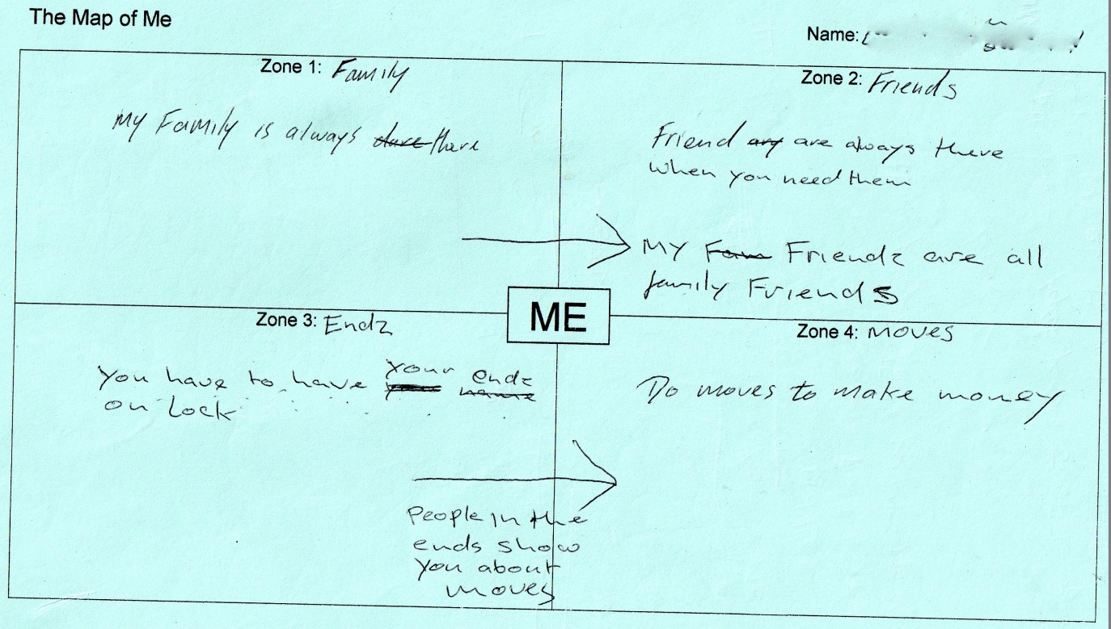
Methodology
Qualitative: Map of Me (Clennon, 2013)

Slide 7
Methodology
Creative Writing: lyrics from Blockz
(Werrington Album, 2007)
“We live our life in the slums around drugs and guns
Our parents got to live off benefit of government funds
We got to sell green and crack to look after our sons
It’s the way that we’re living it’s the way that it runs
I was raised on the block and I was known as a real kid
The government judge me by the way that I still live
Shotting drugs on the block is known as the realness
If you’ve lived the life I’ve lived I know that you feel this”

Slide 8
Methodology
Music Technology: Blockz (track 3, 7:06)
http://www.youtube.com/watch?v=EmZ57b8EI9Q

Slide 9
Use of Liberation Psychology
Conscientization (Freire, 1973)
Using creative writing to uncover and critically reflect on their past as a way of envisioning their future (Martin-Baro, 1994)
Defetishisation: Encouraging the young men to see themselves as human agents capable of self-determination (making choices) rather than being pre-destined instruments of “fate” within the system (of oppression) (Rivera, et al., 2013)
Problematisation (Montero, 2009)

Slide 10
Embedding the research
Performance ethnography
20 weeks (one 2hr session weekly), n=7 (max), 16 – 18yrs
Using writing, performing and recording MC (Rap) tracks as participatory tools to gather qualitative data around the participants’ views about their identities and popular culture.
The use of “on the fly” interviews facilitated by Map of Me questionnaires
  Creative writing sessions (Cleveland, 1992)
Making use of the “flow” (Csikszentmihalyi & Csikszentmihalyi, 1988)

Slide 11
Examples of Conscientization
Performing Masculinities:
Initial lyrics generated from a Map of Me conversation
“I rep for my endz everyday until I’m older
Times have changed the hood’s getting colder
My cousin died my mum cried, I just wanted to hold her
Rest her olive skin, her black hair upon my shoulder
Tell my auntie Sue her kid was a soldier
My cousin went in style that’s all I could of told ya
Reminiscing looking at his pictures in (a) folder
Looking at the sky as the world’s getting colder”

Slide 12
Examples of Conscientization
Performing Masculinities:
Masculinity shaped by “street” violence
Initial lyrics generated from a Map of Me conversation
“The beats ain’t like the streets, the streets fight back
They fight back over coke and crack
‘Cause everyday we got enemies all around us
They pick fights and they try to surround us”
“This shit’s deep, my cousin’s dead
Point blank straight to his head
No hospital nurses
No hospital bed”

Slide 13
Examples of Conscientization
Performing Masculinities:
Masculinity shaped by response to chaotic lifestyle
From a Map of Me conversation
“We live our life in the slums around drugs and guns
Our parents got to live off benefit of government funds
We got to sell green and crack to look after our sons
It’s the way that we’re living it’s the way that it runs
I was raised on the block and I was known as a real kid”

Slide 14
Examples of Conscientization
Performing Masculinities:
Masculinity shaped by “street” violence + Masculinity shaped by response to chaotic lifestyle
=
“hierarchy” of “dominant masculinities” (Newton, 1994) via “siege mentality” (Bar-Tal, 2012, p. 996)

Slide 15
Examples of Conscientization
Hierarchy of dominant masculinities
Initial lyrics for Da Realness
“Every new day in jail you see new faces
If they’re suicidal they take their shoelaces
Couple guys are safe then you meet a few racists
Catch them slippin’ out on social then do basic
I remember the day getting 2 do 2 year
I told my mum that my time will come near
I gotta keep my head up in dis jail a fun fair
I know my real boys cos its starts to come clear”

Slide 16
Examples of Conscientization
Hierarchy of dominant masculinities
“to the weak, helpless, dependent status of childhood” (Sykes, 1958; p. 76)
The formation of Hegemonic masculinities
“embodied the currently most honoured way of being a man, it required all other men to position themselves in relation to it and it ideologically legitimated the global subordination of women to men”
(Connell & Messerschmidt, 2005; p, 832).

Slide 17
Examples of Conscientization
Defetishisation
K’s four themes were: friends, family, crime, prison
K’s summary of his map, ‘When I went inside for stupid crimes that if I thought about how much I would have missed my friends and family [I would have done something different]…I’m not coming back (from his "Map of Me")’
K’s sketch lyrics from his themes are:
Chorus
“When I went inside for stupid crimes
Got pushed in my cell
And I lay down
Started to cry
Missing my mumzy
Missing the road side
Don’t mess up
Stay on the outside”

Slide 18
Examples of Conscientization
Problematisation of Concealing Emotion as an aspect of Hegemonic Masculinity
Cultural heritage as a form of recovering their historical memory was E’s summary of his Map of Me, ‘I like to show people how I feel because (of) where I was brought up’
E’s emerging lyrics from his themes were:
“Verse 1
Ghana is no way like London
We share love but we don’t spread no corruption
London there is bare
No love there.”
E seemed keen to explore the differences between Ghana, where he was born and lived until the age of five and London, where he lived thereafter.

Slide 19
Examples of Conscientization
Personal Liberation
Creative writing useful for personal reflection
Finding ways of curbing his outburst and frustrations
Realises that he cannot look after his family when in jail
Needs to find ways of effecting smooth transition to the outside
Wrote “Holdin’” about love and relationships as a reflection of his personal journey and defishisation. His song is inspired by Mariah Carey’s We Belong Together

Slide 20
Further reading
Read more about this case study at
Clennon, O.D. (in press) ‘Holdin' On: A case study into performing masculinities at a young offenders' institution ‘, in Afuape, T. and Hughes, G. (eds.).Towards emotional well-being through Liberation Practices: a dialogical approach'. London: Routledge
References
Bar-Tal, D. (2012). Siege Mentality. In D. J. Christie (Ed.), The Encyclopedia of Peace Psychology (Vol. 1, pp. 996 - 1000). Chichester: Wiley-Blackwell.
Clennon, O. (2013). How effective are music interventions in the criminal youth justice sector? Community music making and its potential for community and social transformation: A pilot study. Journal of Music, Technology & Education, 6(1), 103 - 130.
Cleveland, W. (1992). Art in Other Places: Artists at Work in America’s Community and Social Institutions. Westport: Praeger.
Connell, R. W., & Messerschmidt, J. W. (2005). Hegemonic Masculinity: Rethinking the Concept. Gender and Society, 19(6), 829 - 859.
Csikszentmihalyi, M., & Csikszentmihalyi, I. (1988). Optimal Experience: Psychological Studies of Flow in Consciousness. Cambridge: Cambridge University Press.
Freire, P. (1973). Pedagogy of the oppressed. New York: Seabury Press.
Martin-Baro, I. (1994). Writings for a Liberation Psychology. New York: Harvard University Press.
Montero, M. (2009). Methods for liberation: Critical consciousness in action. In M. Montero, & C. Sonn (Eds.), Psychology of liberation: Theory and applications (pp. 73 - 93). New York, NY: Springer.
Newton, C. (1994). Gender Theory and Prison Sociology: Using Theories of Masculinities to Interpret the Sociology of Prisons for Men. The Howard Journal, 33(3), 193 - 202.
Rivera, E. T., Maldonado, J., & Alarcon, L. (2013). From Vygotsky to Martín Baró: Dealing with Language and Liberation During the Supervision Process. Universal Journal of Psychology, 1(2), 32 - 40.
Sykes, G. M. (1958). The Society of Captives (1971 ed.). Princeton: Princeton University Press.
HMPYOI Werrington . (2007). Werrington Album. [mp3]. Stoke-on-Trent, Staffordshire, UK Available at http://youtu.be/EmZ57b8EI9Q and http://youtu.be/PI4fPL_69HE.

Slide 21
Holdin’ (OB’s remix)
http://www.youtube.com/watch?v=PI4fPL_69HE

